Slide 1
Lab (2) Laboratory work flow cycle For 2nd year student
Ibn Sina University of Medical
and Pharmaceutical Sciences
College of Dentistry
Clinical Biochemistry Lab
Done by: Ass. Lec. Farah Saadoon Jaafer
M.SC. in Inorganic Chemistry

Slide 2
Outline
Clinical biochemistry Laboratory work flow cycle .
Phlebotomy.
Quality Control.
The Interpretation of Results.

Slide 3
The Laboratory work flow cycle
Every biochemistry analysis should attempts to answer a question which the clinician has posed about the patient obtaining the correct answer can often seem to be fraught with difficulty. So, there are three phases of laboratory testing:
Pre-analytical: test ordering, specimen collection, transport and processing
Analytical-testing
Post-analytical: results transmission, interpretation, follow-up, retesting.
The following figure show (Circuit diagram of clinical biochemistry process).

Slide 5
Phlebotomy
Phlebotomy : the act of drawing a blood sample from a blood vessel (a vein, artery, or the capillary bed) for lab analysis or blood transfusion. For clinical chemistry testing blood is usually drawn from a vein, typically a vein in the arm or back of the hand. Collecting blood from a vein is called venipuncture. The medical professional drawing the blood sample is called a phlebotomist. For blood collection, the following materials are required 

Slide 6
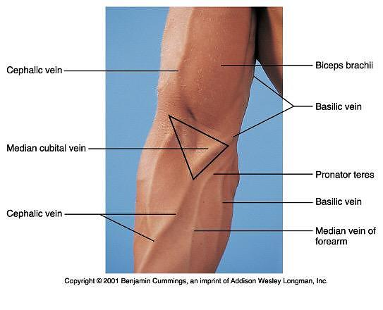
- Selection of vein site:
Usually vein is used to collect blood by venipuncture procedure.
On arm, there are three veins that can be used in blood collection: median cubital vein "located on the middle", cephalic vein and basilic vein "located on both sides".
Median cubital vein is the best choice because it has good blood flow than cephalic and basilica which has slower blood flow.
However, if venipuncture procedure is unsuccessful in median capital; cephalic or basilic is used.
Artery blood is rarely used in special cases as when blood gases, pH, CO₂, O₂ and bicarbonate is requested. It is usually performed by physicians.

Slide 7
- Basic steps for drawing a blood specimen:
Preparation for blood collection.
The information given on the blood request form should be recorded on the specimen labels essential items include the following.
Patients complete name and age.
Identification number.
The specimen containers should be labeled appropriated before the specimen collection.
Ascertaining whether the patient to fast such care is needed to ensure accurate results.
The technician must gain the patients confidence and assure him that, although the venipuncture will be slightly painful, it will be short duration.
Positioning the patient :
The patient should be made to sit comfortably in a chair and should position his arm straight from the shoulder and it should not bent at the elbow.
If the patient wants to lie down, let the patient to lie comfortably on the back, the patient should extent the arm straight from the shoulder.
** Note that minimum use of tourniquet is advised because blood constituents may be changed due to prolonged venous occlusion.

Slide 8
Quality Control
Biochemical measurements vary for two reasons. There is analytical variation and also biological variation. A number of terms describe biochemical results. these include:
1- Precision and Accuracy
Precision is the reproducibility of an analytical method. Accuracy defines how close the measured value is to the actual value.

Slide 9
Quality Control
2- Sensitivity and specificity
Sensitivity of an assay in a measure of how little of the analyte the method can detect, As new methods are developed they may offer improved detection limits which may help in the discrimination between normal results and those in patients with the suspected disease. Specificity of a assay related to how good the assay is at discriminating between the requested analyte and potentially interfering substances.

Slide 11
The Interpretation of Results.
It can take considerable effort, and expense, to produce what may seen to be just numbers on pieces of paper, understanding what these numbers mean is of crucial importance if the correct diagnosis is to be made, or if the patients treatment is to be changed. Usually results of tests carried out in clinical chemistry are reported in units of concentration or of activity.
1- Concentration :
Units of concentration contain both units of quantity and units of volume. The amount of substance present can be expressed in grams, equivalents, or moles or divisions of these ie. milligrams, milliequivalents millimoles etc. similarly the volume can be expressed in liters milliliters or deciliters (100 ml).

Slide 12
The Interpretation of Results.
2- Units of activity :
Usually activities are measured in clinical chemistry as an index of the concentration of certain enzymes, or enzymatic processes e.g. prothrombin activity. Activity is a measure of the rate at which a process takes place. Enzymatic activity is usually estimated by measuring the rate at which a substrate is converted to a product. This activity is affected by many things e.g. temperature, time over which the activity is measured, incubation conditions etc. All of these must be defined when reporting the activity and so units or activity include fixed values for each variant.

Slide 13
Conventional unit : g/l ; g/dl ; mg/dl
Systematic international unit (SIU) : mmol/l ; meq/l ; IU/l
mmol/l = (mg/dl × 10) ÷ molecular weight of molecules
mmol/l = (mg/dl × 10 × Valance) ÷ atomic weight of atom

